Slide 1

The Inspired Arts
Taylor Ward

Slide 2


Overview
Located in Dudley, Ma
5 minutes from Copper Beach II
Has 4 dance rooms; a kitchen, 2 bathrooms, front desk, play room, office, store and tanning room
Dance Studio opened in 2015 (sole-proprietorship)
15 employees around 80-100 dancers
Notes:
Explain studio set up- means a lot to juggle
Explain what store is

Slide 3
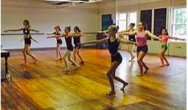


Offering
Dance
Workout
Competition
Recreational
Ballet/Pointe
Tap
Jaz
Hip hop
Modern
Acro
Musical Theater
Bodypump
Bodystep
Bodycombat
Bodykamp
Bodyattack
Bodyflow
CX Work

Slide 4
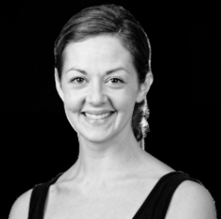
Nikki Mead
Danced growing up at Kimberly's School of Dance Education
Became very well known for her tap style
Worked with famous choreographers throughout various convention outlets
Went to Eastern Connecticut State University and doubled majored in Fine Arts-Dance and Business Administration
Performed on ECSU Dance team (captain and coached)
Coach of Nichols Dance Team 2016-2018
Now has her own studio

Slide 5
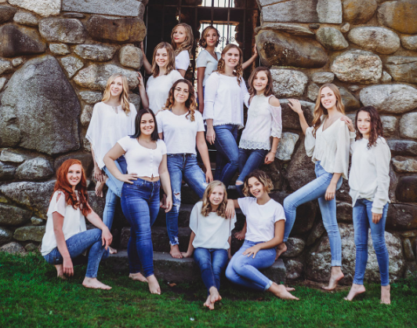
Challenges vs Successes
Challenges:
-Coronavirus
-Teaching the staff
-Helping people use the new system
Successes:
-Learned a new system I can use for my studio (wellness living)
-Do's/don't for my studio
-Helped run backstage at a showcase
-Learned apps to create FREE poster to post on social media (Canva)

Slide 6
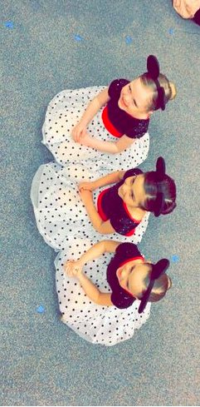
Responsibilities
-Ensure that all members of the workout program are accurately checked in for their specific classes and payment is complete (Monthly, drop-in, yearly)
-Ensure that all dancers at the showcase are checked-in one dance before routine, properly costumed and ready for their time on the stage.
-Ensure costumes for showcase are checked-in (Which will be worn for competition and recital as well). Which entails costume is not ripped, fits and all pieces are there and given to dancer.

Slide 7
What I need to do to achieve these goals:
Being patient
mature to handle/separate business from friends
having a good temperment working with children
trust in your fellow employees
stressful/crammed times.

Slide 8
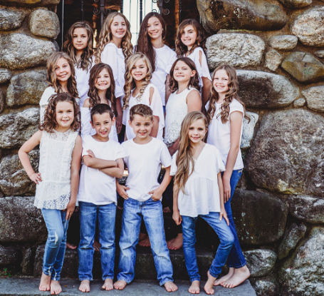
My time at T.I.A
I started off scanning/checking people in for workout classes
Then I started to watch the children
In February I helped work backstage for their annual show case
Started to help prep for competition season
With my time coming to an end:
  Started training a new worker to use the new system

Slide 9
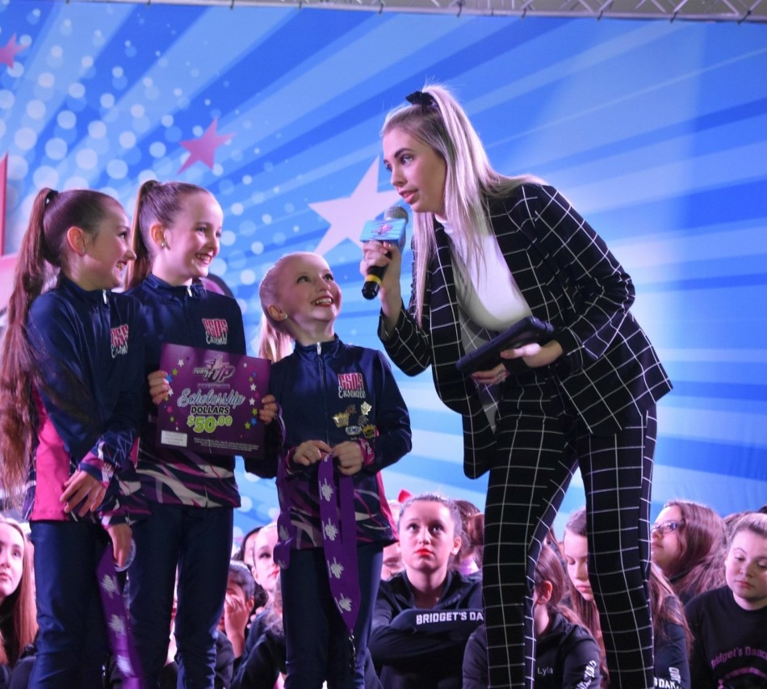
How I helped
By checking people in this saved Nikki personal time at home
Relieving stress by doing the little stuff
With covid-19 I am helping rearrange their competition schedule
Working with Turn It Up dance Competition
Made a google docs for each previous comp and their judges feedbacks
Notes:
-first: at night she would have to go to every workout class and zoom in on everyone faces and enter them in because people never were true and clocked in
-second: by doing back stage, costume and little things she need dones allows her to focus on major issues (as if she had a assitant that big corp have)
-third: she is extended the dance season till august instead of june (pushing back comps, nationals and recital)

Slide 10
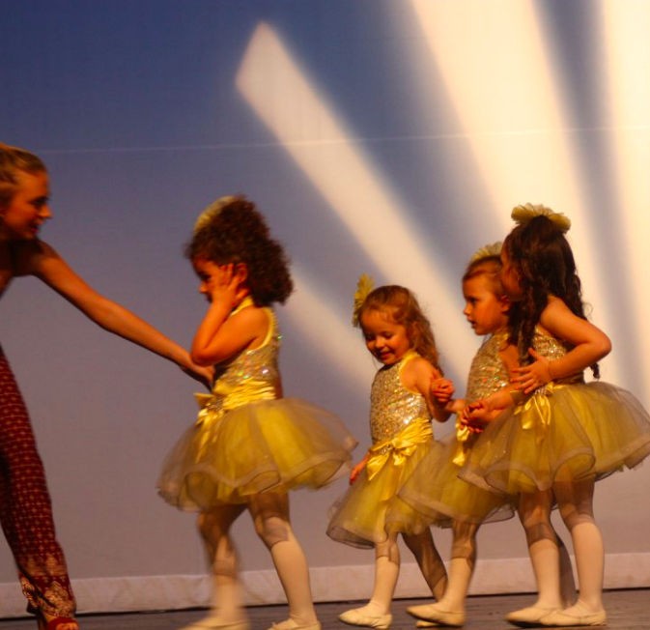
What I learned
Software I can use in my future dance studio
Do/Don't how I will run my studio
Different teaching styles
Pricing
I should hire someone like me
I still want to open my own studio

Slide 11
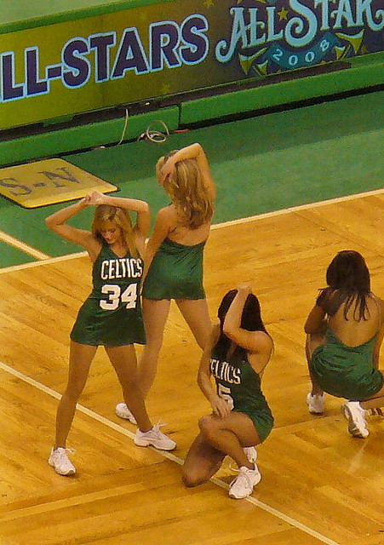
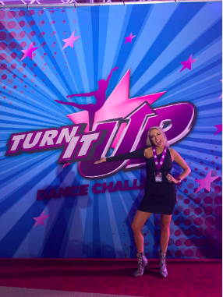

My future
After graduation (whenever that will be) get back into physically dancing
With hopes of auditioning for the Celtics Dancers
I will continue to work for Turn It Up Dance competition to build my resume
Start teaching at a local studio wherever I may land
In 10 years have my studio up and running
This Photo by Unknown author is licensed under CC BY-NC-ND.

Slide 12
How could you not love this internship
https://www.youtube.com/watch?v=4qxf5de5Clk
https://www.youtube.com/watch?v=l6fUiaEIJPI

