Slide 1
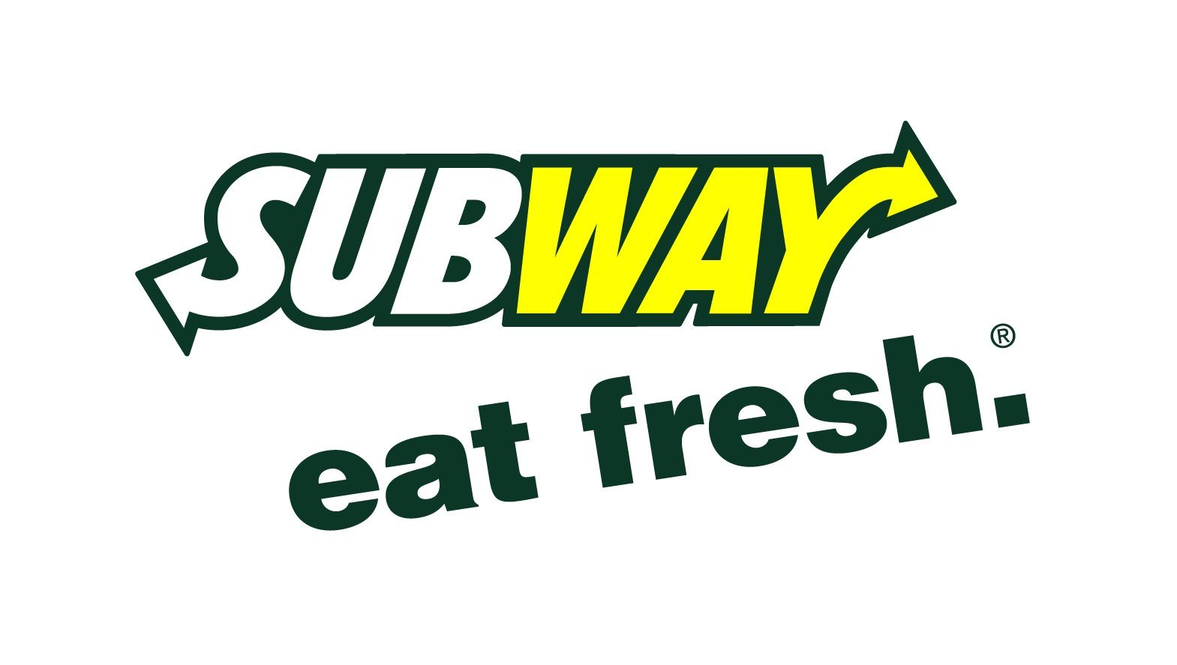

Slide 2
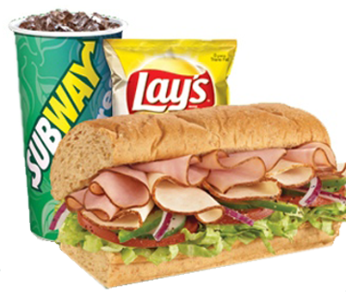
Overall Description:
Franchise owner - Krishna Patel
Location – 188 Gore Road, Webster, MA
"Subway is an American privately-held restaurant franchise that primarily sells submarine sandwiches and salads. It is one of the fastest-growing franchises in the world and, as of October 2019, had 41,512 locations in more than 100 countries. More than half its locations are in the United States."
Appeal as a healthier fast food option

Slide 3
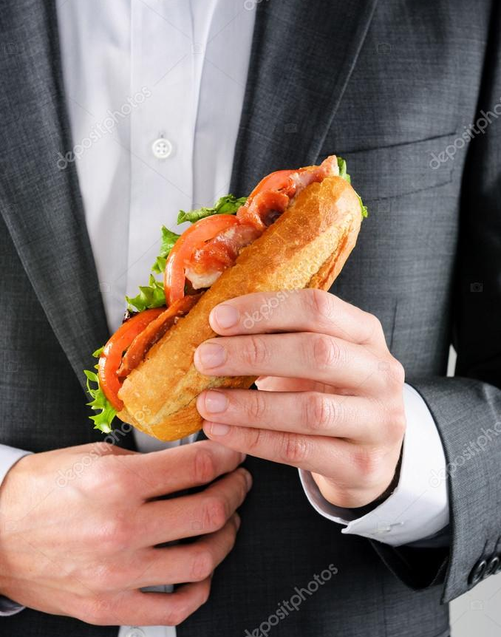
Subway Franchises:
Avg. cost to open a franchise - $116,000 to $263,000
"Franchisees pay 12.5% every week (gross sales minus the sales tax); 8% goes toward the franchise royalties and 4.5% goes towards advertising."
The franchise fee is $15,000.
Offer financing and leasing programs
"Territory Granted: Franchisees will not receive an exclusive territory under the Franchise Agreement or any related agreements. The franchisor may grant franchisees limited exclusivity rights to a territory under its Exclusive Area Development Program."

Slide 4
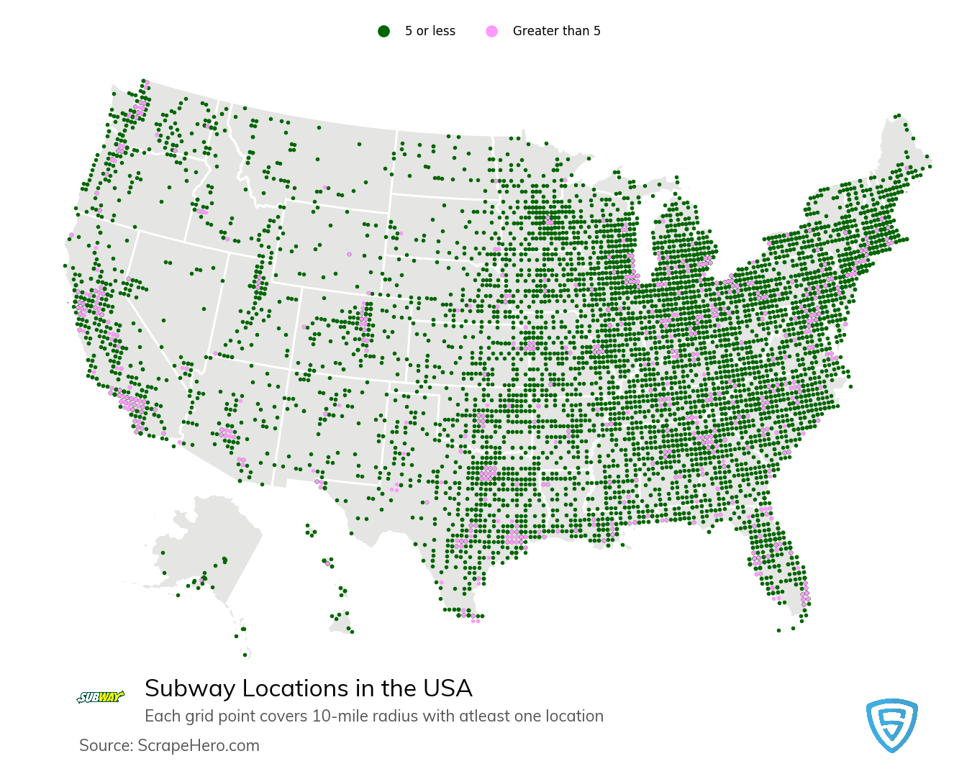
Corporate staff seems very supportive of new franchisees...
"Perfect location" selection assistance
Week of training at World Headquarters
Easy to contact with questions
Applying for franchise available to anyone
Regional "Development Agents" (franchise managers)

Slide 5
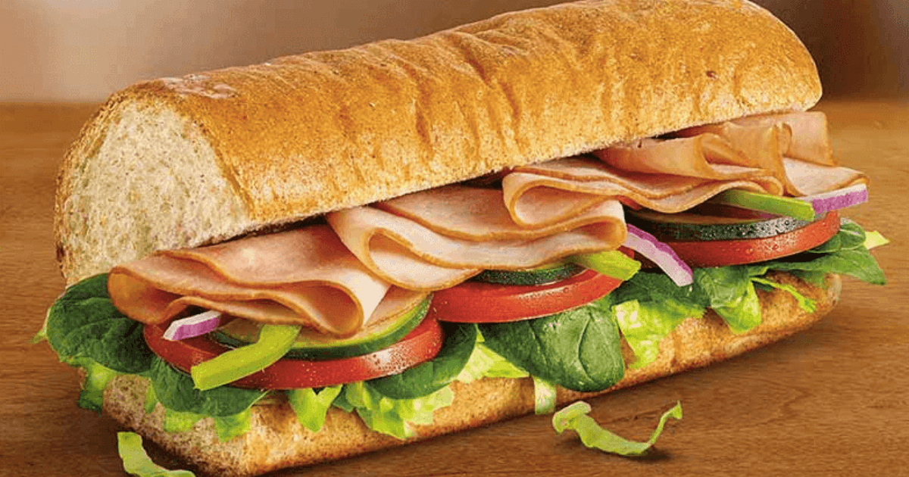
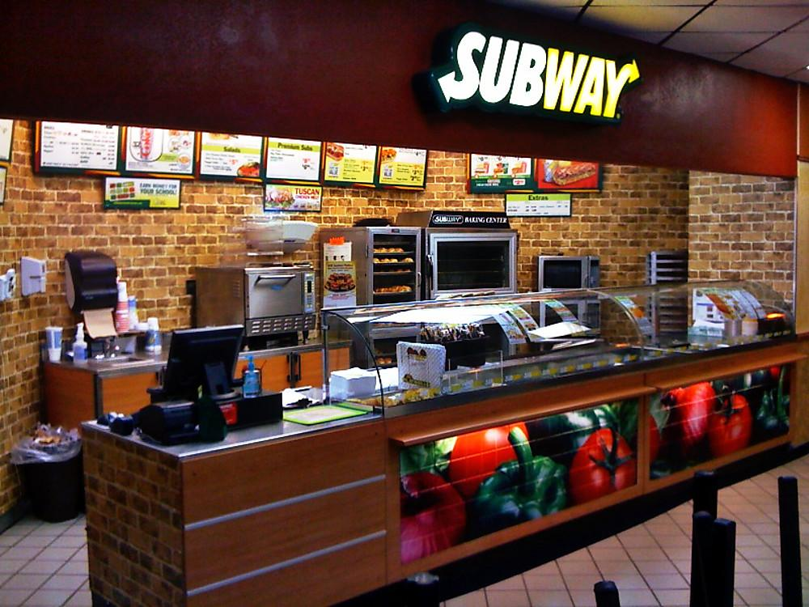
From a Franchise Owner...
Krishna Patel – Webster, MA
774-334-2162

Slide 6
The Interview:
Q: Are you happy with your relationship with the franchisor? Explain.
A: Yes. Subway always maintains a good reputation with customers, while ensuring their franchisee's success.
Q: What changes would you make to the franchisor’s business system?
A: None. Simple to start franchise with corporate support.
Q: What did it actually cost you to get your franchise running? How close was the actual amount to the amount the franchisor told you it would cost?
A: About $200,000, exactly within their estimated range.
Q: Is your franchise profitable? How long did it take for your franchise to break even? How much does your franchise earn? How variable are your franchise’s earnings? Are the earnings consistent with your expectations?
A: Yes. With assistance from Development Agent purchasing ingredients. Sales slightly vary year-round.

Slide 7
Q: Did the franchisor estimate accurately the amount of working capital necessary to sustain your business until it began generating positive cash flow?
A: -
Q: What is the training program like? Were you pleased with the training you received from the franchisor? Did the training prepare you adequately for operating your franchise successfully?
A: Training at Subway Franchise World Headquarters in CT. Yes, training prepared for day to day business operations.
Q: Did you encounter any unexpected franchise fees or hidden costs? If so, what were they?
A: No, they warned of all potential costs and how much they would be.
Q: Are you pleased with the size of your territory? Is it large enough for you to reach your sales and profitability goals? What kind of territorial protection does the franchisor offer?
A: No territory agreement, but no other Subway locations in town. "Exclusive Area Development Program"

Slide 8
Q: What restrictions do you face on the products and services you can sell? Are you required to purchase from approved suppliers? Are their prices reasonable?
A: Limited to items on the menu at a given time, must learn new products on menu. Assisted by Development Agent to find best priced products.
Q: Does the franchisor advertise as much as it said it would? Is the advertising effective in producing sales? Do you receive adequate support from the franchisor now that your outlet is in operation?
A: Advertisements are adequate, effective commercials/sponsors.
Q: What kind of education and business experience do you have? How important have they been to your success in the franchise?
A: The Bachelor of Science in Business Administration(BSBA). Family owned a business in India.
Q: What is it really like to be a franchisee in this system?
A: Rewarding. Like owning a small business, but much harder to fail.

Slide 9
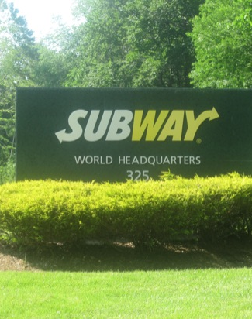
Q: If you were considering investing in this franchise again, what would you do differently?
A: Saved more capital to start, things could have been easier. Better timing with young children.
Q: Given what you know now, would you purchase this franchise again?
A: Yes. Very supportive corporate programs.
Q: How much control does the franchisor exercise over you and the way you run your franchise?
A: The people do not control much, but the way the business is designed does not allow much freedom.

Slide 10
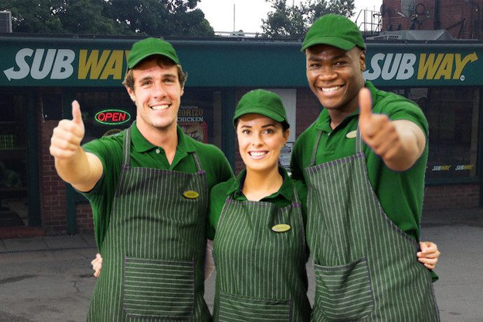
https://www.subway.com/en-US/OwnAFranchise

