Slide 1
NBA Salaries 2019-20
By Nicole Burdiel

Slide 2
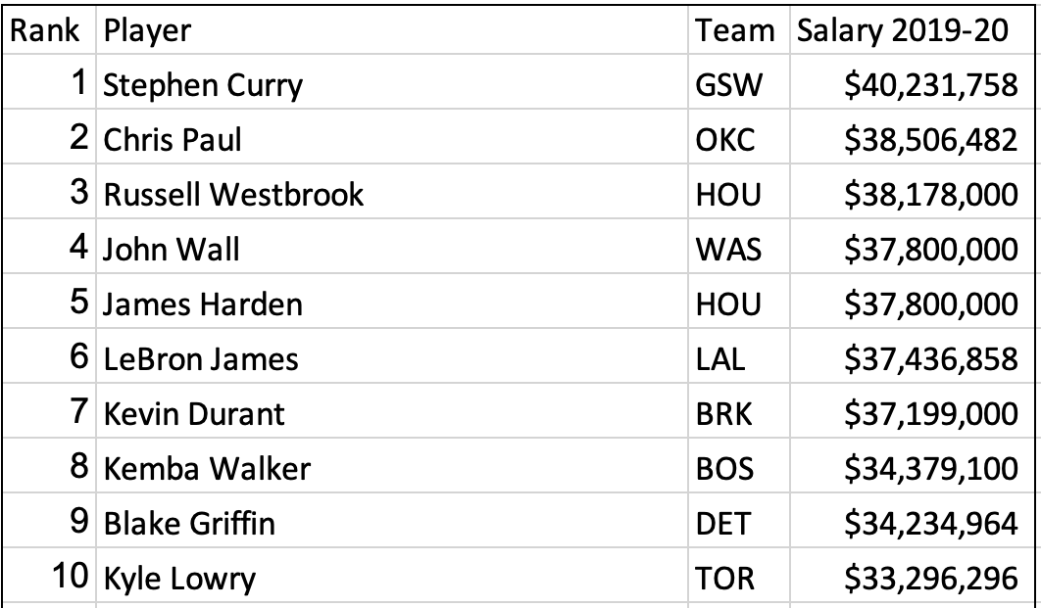
Top Ten Highest Paid NBA Players

Slide 3
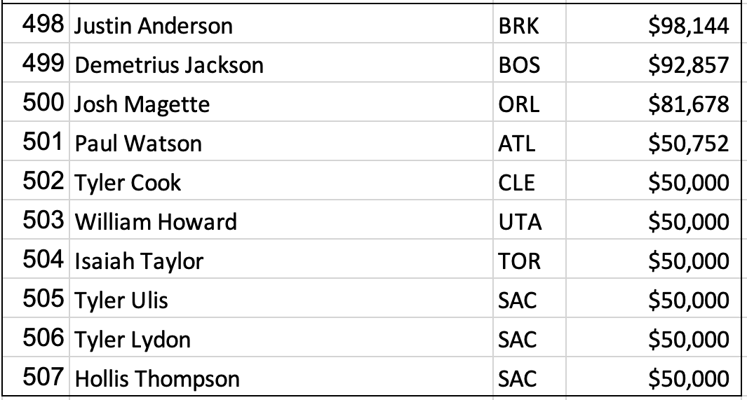
Top Ten Lowest Paid NBA Players

Slide 4

Top Ten make well over $30 million
Lowest Paid earn less than $1 million

Slide 5
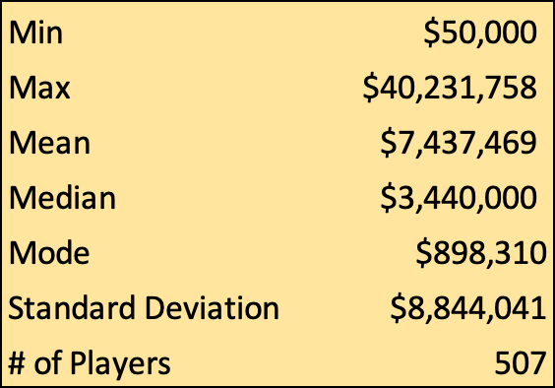
Central Tendency

Slide 6
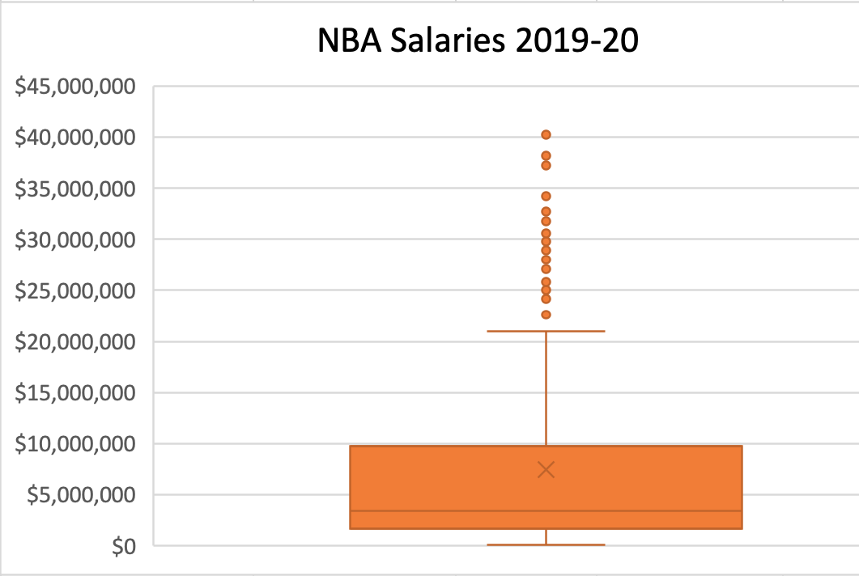
Box-and-Whisker Plot

Slide 7
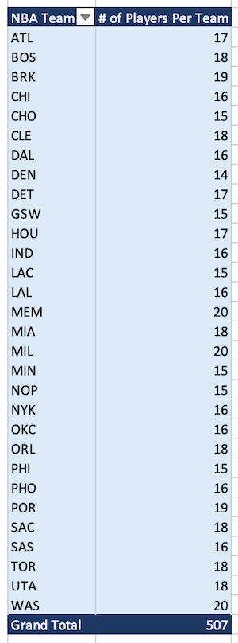
Number of Players Per Team

Slide 8
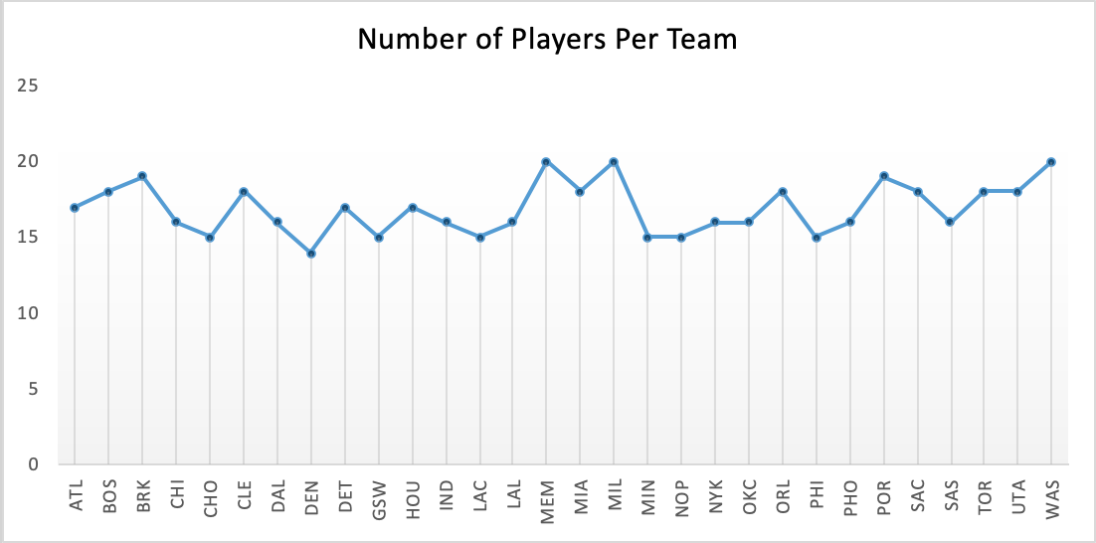

Slide 9

Memphis Grizzlies have the highest number of players
Denver Nuggests have the lowest

Slide 10
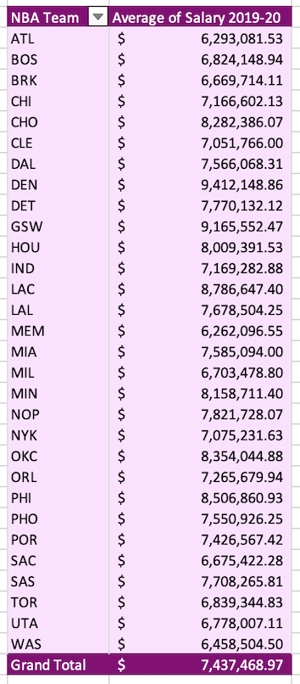
Average Salaries Per Team

Slide 11
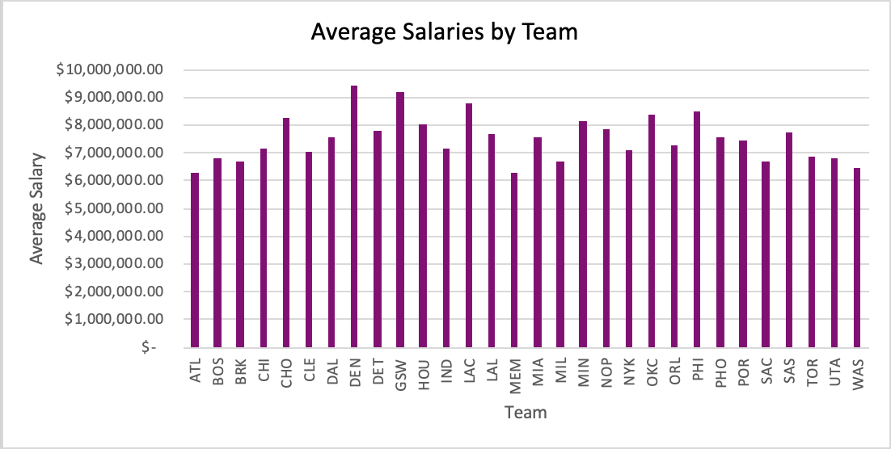

Slide 12

Denver Nuggets pay the highest
Memphis Grizzlies pay the lowest

Slide 13
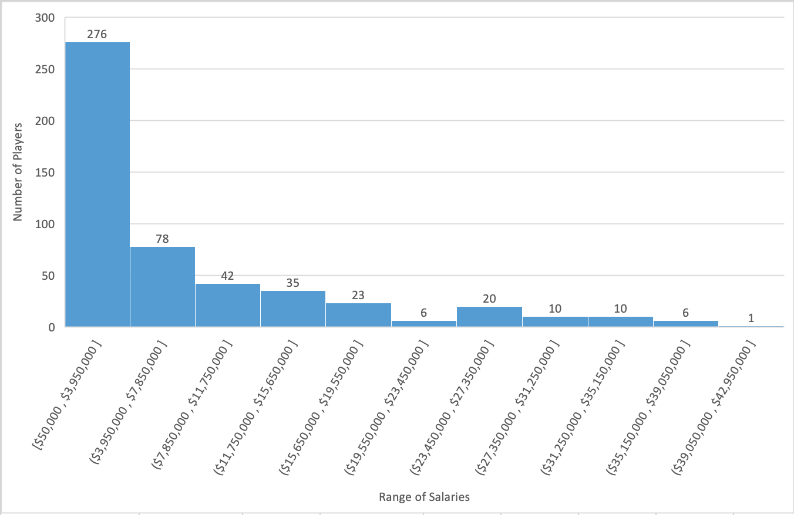
Number of Players In A Range of Salaries

Slide 14
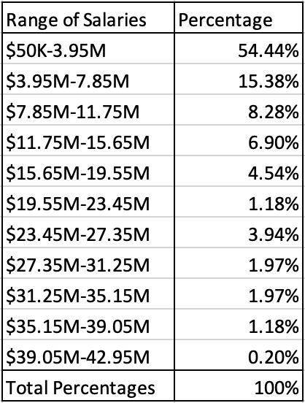

Slide 15
