Slide 1



Statistics Project
By: Jason O'Regan and Elijah Moreno-Winston

Slide 2
Questions
Do you play a varsity sport?
Do you think playing sports affects your grades?
How many hours a week do you practice/play?

Slide 3
Introduction
How we created our bias:
To create bias we asked our question in different ways, we asked athletes around campus our question along with non-athletes accepting answers from both sides
For half of the students we asked, we wore sports apparel that would let our audience know we ourselves were student athletes
Why did we choose this topic?
We thought this topic would be interesting because of the scrutiny that student-athletes face or the stereotypes centered around student athletes and their grades.

Slide 4
Methodology
How we conducted our experiment:
We asked 140 students overall our set of questions
We wore our basketball gear for 70 of those "interviews" and wore regular clothes for the other 70.
We asked this question across many college campuses including Nichols, Elms College, AIC, Worcester State and Springfield College.
We asked our questions to athletes and non-athletes.
How was this effective?
It showed us what people really thought about balancing sports and school.

Slide 5
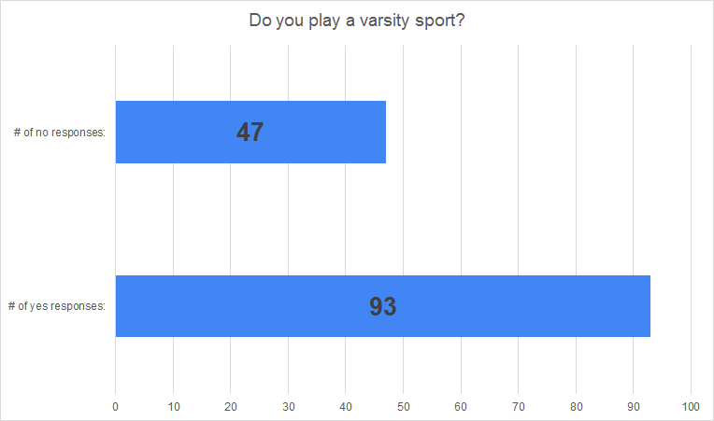
Survey Results
Out of the 140 students we asked, 47 were non-athletes and 93 were athletes.
We asked this question to help eliminate bias answers based on whether or not the individual we asked was an athlete or not.
We also wanted to see if there was indeed a bias towards whether or not being an athlete played a role in if you thought your activities affected your grades.

Slide 6
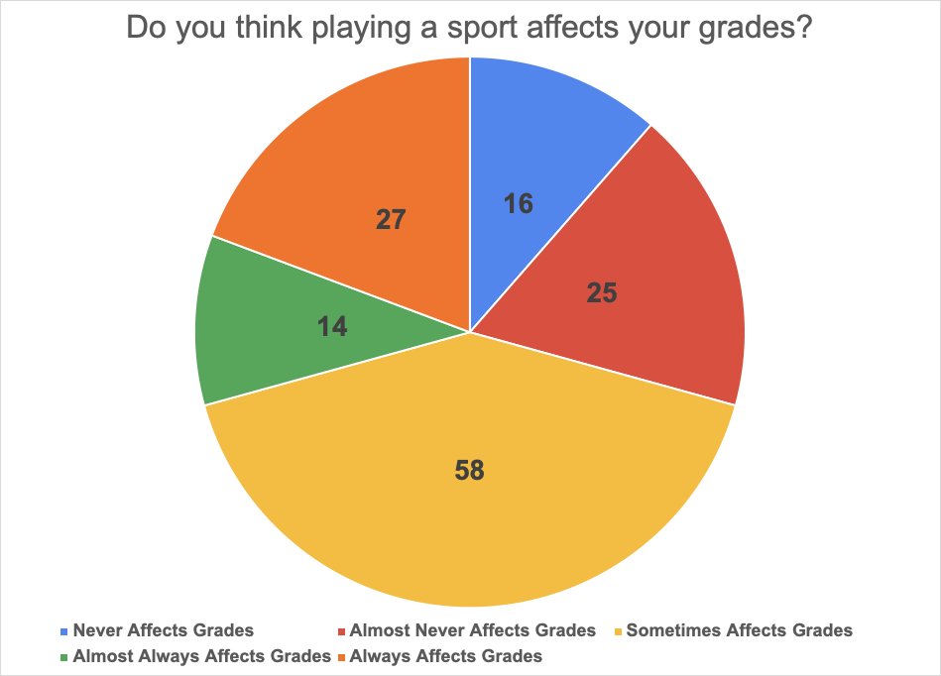
58 students said that sometimes sports affects your grades.
27 students said sports always affects your grades.
25 students said sports almost never affects your grades.
While 14 students said sports almost always affects your grades AND 16 said sports never affects your grades.

Slide 7
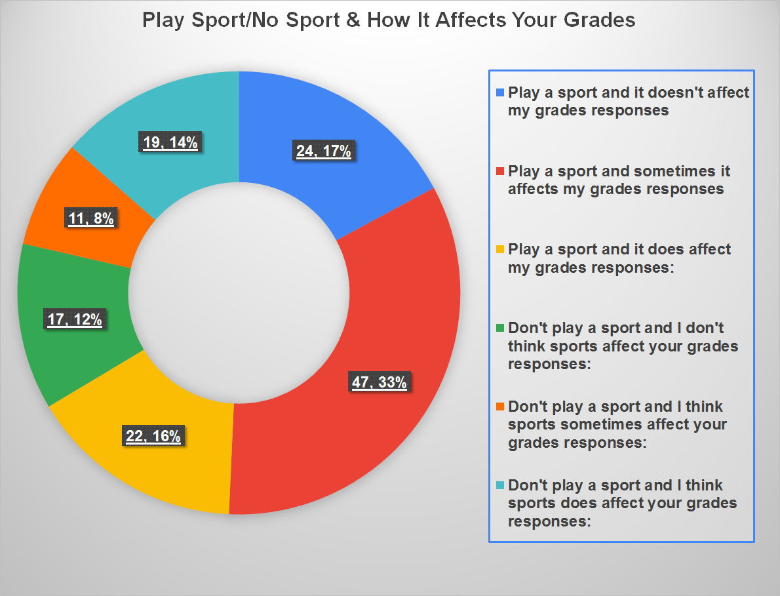
Survey Results
This charts shows and breaksdown if playing a sport vs. not playing a sport affected the opinion we recevived about how being an athlete could affect your grades.

Slide 8
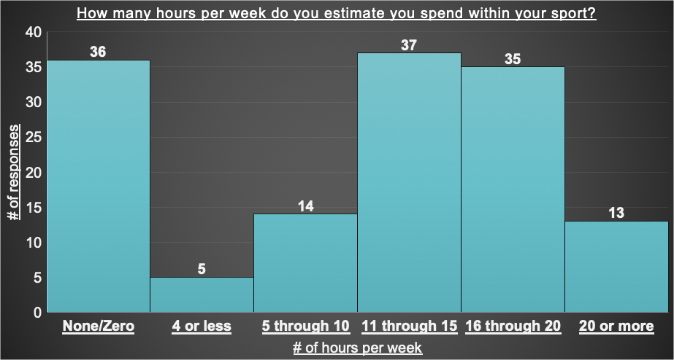
Survey Results
Mean: 10.75
Median: 13
Mode: 13
Min: 13
Max: 22
Range: 9
St Dev: 7.78
Variance: 60.52

Slide 9
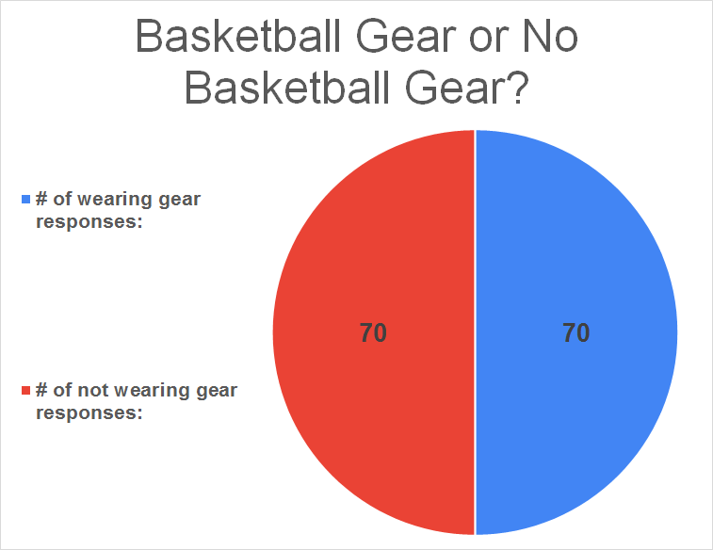
Survey Results
This charts just shows that we split our bias right down the middle and asked 70 people with our basketball gear on and 70 people without our basketball gear on.

Slide 10
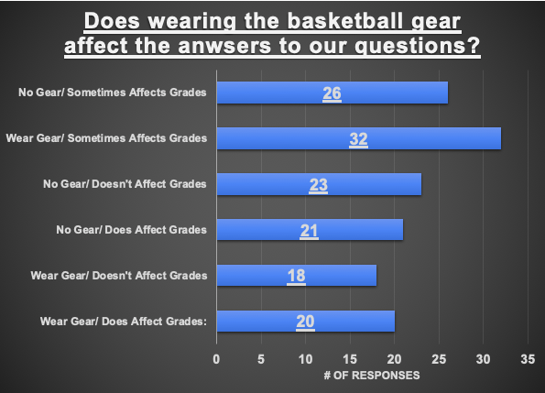
This chart shows if two biases were in fact created when we asked an individual if they played or didn't play a sport while we ourselves were either wearing our basketball gear or not.

Slide 11
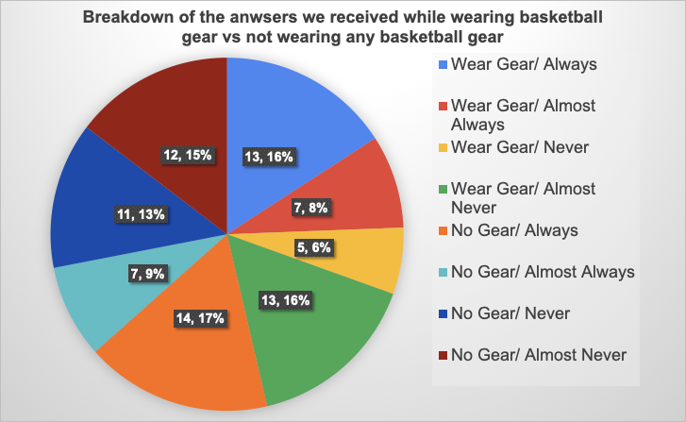
Survey Results
This charts shows while we were wearing our basketball gear or not what anwsers we receieved from individuals.

Slide 12
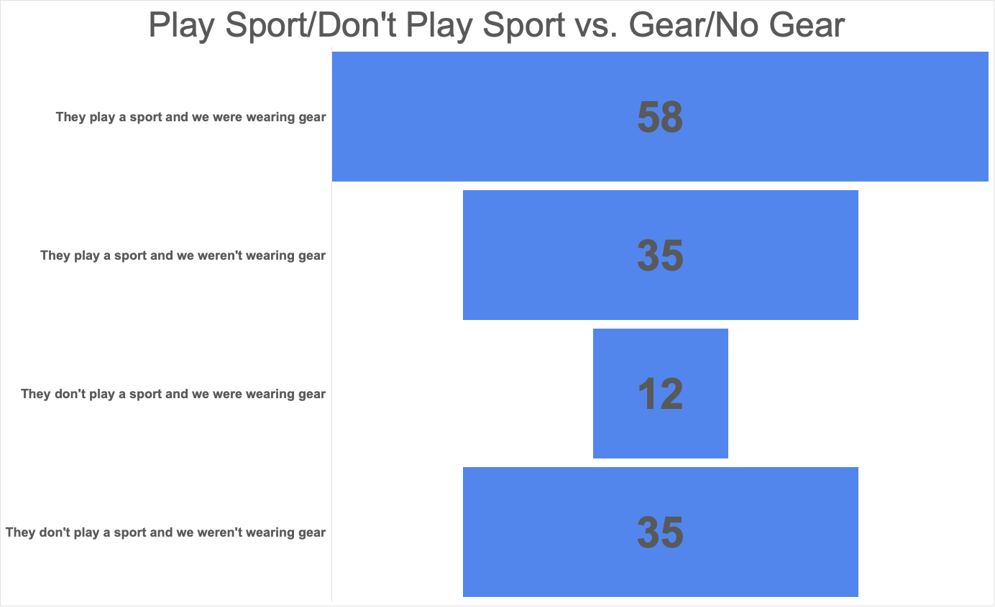
Survey Results
This chart shows the number of people who played or didn’t play a sport while we were wearing our basketball gear or not.

Slide 13
Conclusions
From this experiment we can conclude, overall no matter if the student was an athlete or not and whether we were wearing our basketball gear or not that the consensus was playing sports "sometimes" affects your grades.
These results were important to gather to spread awareness of the affects that sports do have on an individuals' success within the classroom.
These results that we gathered are important to help teachers, student-athletes, and regular students alike to help understand that being a studen-athlete is not easy and does affect your schooling more than one may think.
Students who played sports were more likely to say sometimes sports affects their grades. While students who didn't play sports thought that sports did affect an athlete's grades.
While we were wearing our gear most people still said sports does sometimes affect an athlete's grades. While we weren't wearing our gear students still said that they believed sports sometime affected an athlete's grades.

Slide 14
Conclusion
Early on, we encoutered a problem of not creating a real bias but just asking only athletes and non-athletes so we decided that we would wear our basketball gear to ask half of our sample and not wear any basketball gear for the other half of our sample to create bias.
If we had to repeat this experiment, I would want a larger sample and I would extend our experiment to not only include students but to include professors and adults.
Outside of the conclusions we came to from the experiment, this project also helped us both learn how to use Microsoft Excel more efficientely. While we learned ultimately from our experiment, that the overall thought is that sports does affect your grades.

