Slide 1

The Strand
Alexis Lima

Slide 2
Background
Opened in 2007 and established as an LLC
Woodstock, CT
The Stand was originally owned by a woman named Melinda White
Melinda moved to Florida and sold the salon to a manager, Danielle Carlson
Danielle bought the salon for $50,000
Melinda was in debt $40,000 leaving not much room for profit the first couple years

Slide 3
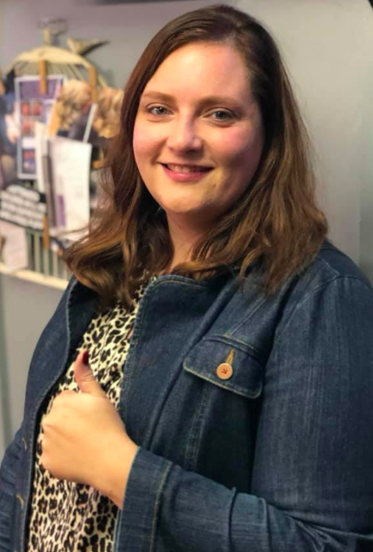
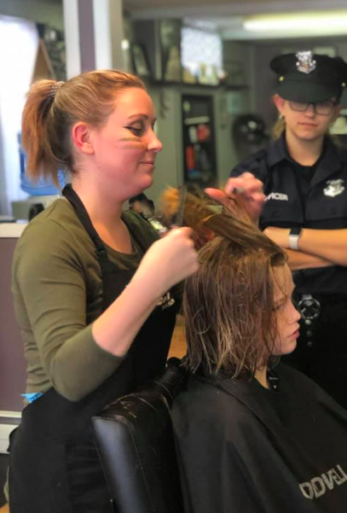
Organization of the company
Danielle is the sole owner of the company
She does all the management duties
There are currently 7 employees beneath her
She does not like people renting the chairs and is extremely picky who she hires

Slide 4

Product and Services
We are an environmentally friendly salon and take great pride in offering our guests eco-friendly products, services and experiences. #greencirclesalon
All organic product:
Don’t use water in the product
Smaller amount of use so it last longer
More expensive
Most product is from Australia

Slide 5
Product and Services Cont.
Facial and Body Waxing
Nails
Facials
Blowdry Bar
Cezanne Smoothing Treatments
Upstyling for Proms and Special Occasions
Bridal Services
Briday and Formal Make Up
Fashion Creative Color
Corrective Color
Bayalage. Ombre’
Haircutting
Foiling
Color Balance
Regrowth Retouch
Color Glazing/Toning
Mens reshade
Hair and Scalp Treatments

Slide 6

Failures
She bought a business that was already $40k in debt
It took a few years to breakeven and when they did it was only $3000
Trying to expand but is having problems finding a new location
Board of health will not allow the amount of water usage
Trying to track how much water she uses now
Could be resolved because current location is also renovating
This Photo by Unknown Author is licensed under CC BY

Slide 7
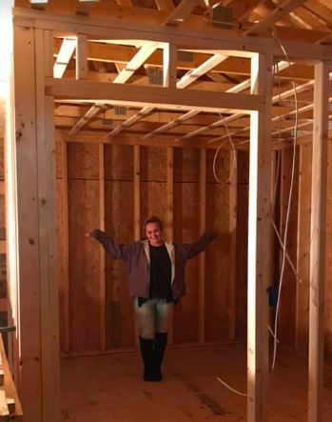
Successes
Paying off their debts
Cliental has grown a lot
Almost all by appointment only now
Bookings months in advance

Slide 8
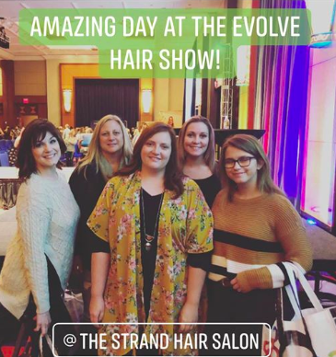
Future Business Plans
Still looking for a new place for space
Potentially opening another salon once the capital is there

Slide 9
Competitors
In Woodstock not many
In Thompson about 5
Competitive advantage are classes that she makes her, and her staff attend to stay up to date and relevant.
Not many people in the area do this
Always learning new things
Products are better for your hair as opposed to others
They are a green circle salon all hair, color, and metal gets recycled

Slide 10
Advice
Constantly be willing to learn
Make sure your employees are up to date and present the company well
It isn’t easy and sometimes things are negative but with enough work/time invested it’ll pay off

Slide 11
Questions
Do you think Danielle should open another salon? Why or why not?
How do you think she can attract more clients?

