Slide 1
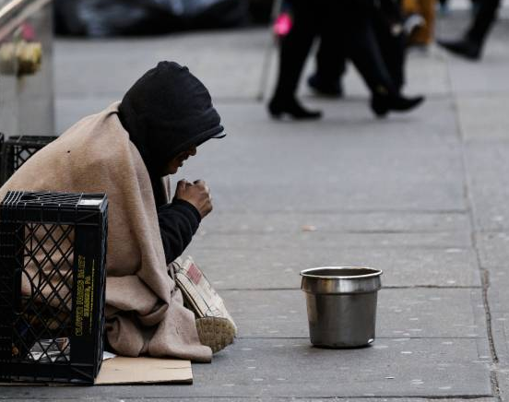
Poverty vs. Unemployment Rate
Summer Dudley

Slide 2
Introduction
Question: Does the Unemployment Rate effect the poverty rate in the U.S.?
Hypotheses: Yes, those who are unemployed lose income therefor are more likely to fall beneath the poverty line.

Slide 3
My Method
I chose this study because:
I thought it was interesting and it was worth researching
I did my research by:
Looking at government websites and the U.S. census
Some data needed extra research
My original plan:
Homelessness vs. the Unemployment Rate
Was unable to do, due to lack of homeless research

Slide 4
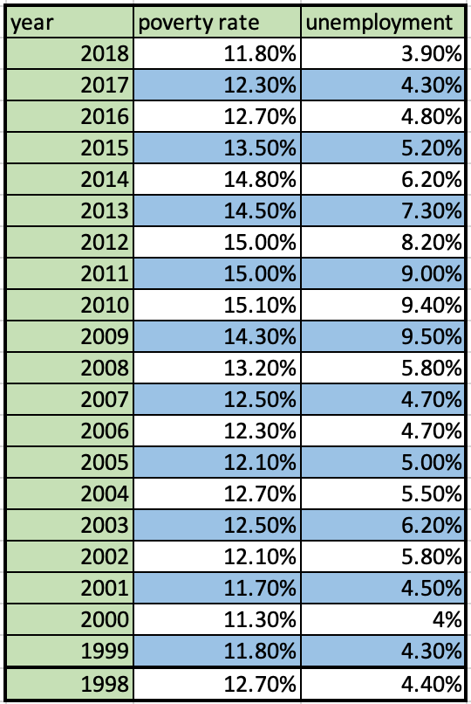
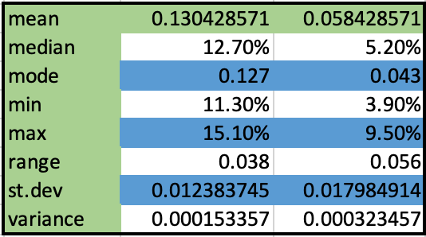

Slide 5
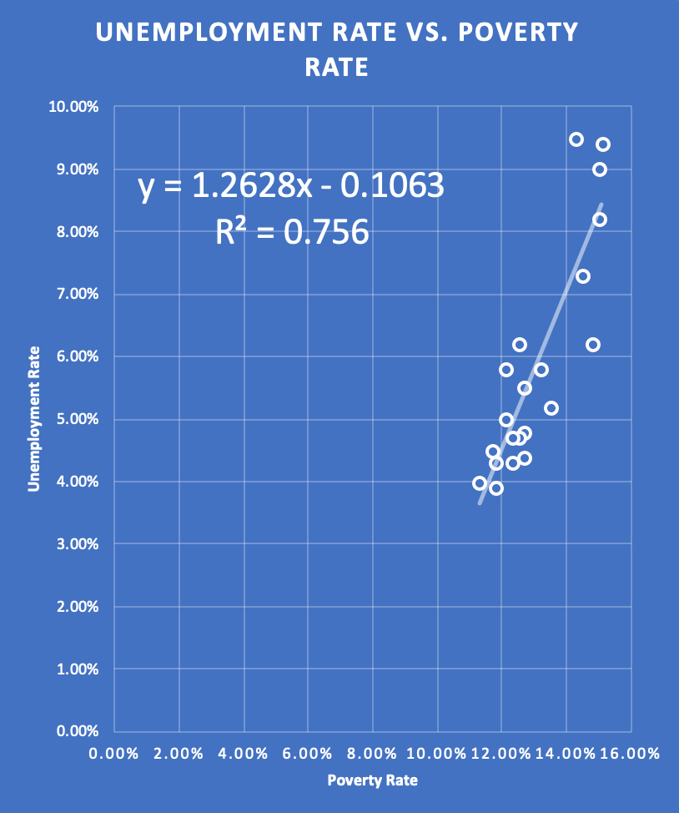
What percent of the population is unemployed if 10% is in poverty?
  1.9% or 2%
What percent of the population is unemployed if 16% is in poverty?
  9.5%
R = .8695, which means there is positive correlation

Slide 6
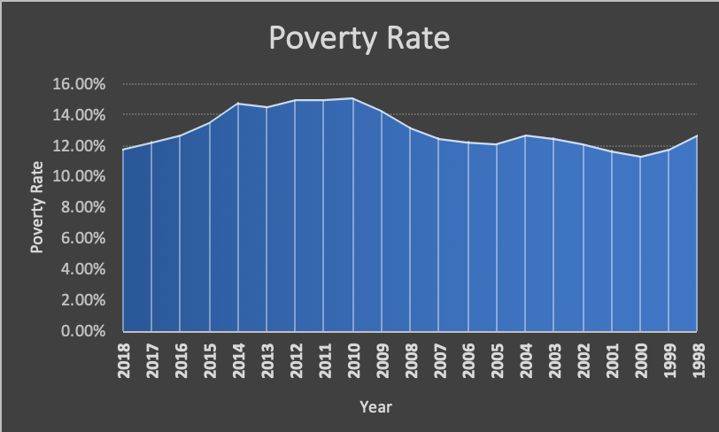

Slide 7
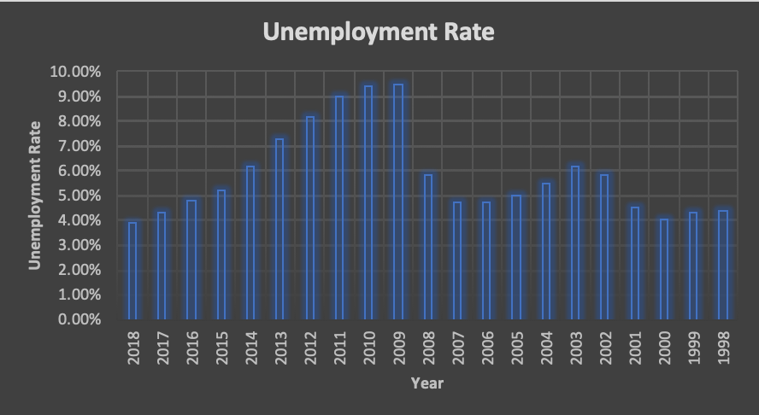

Slide 8
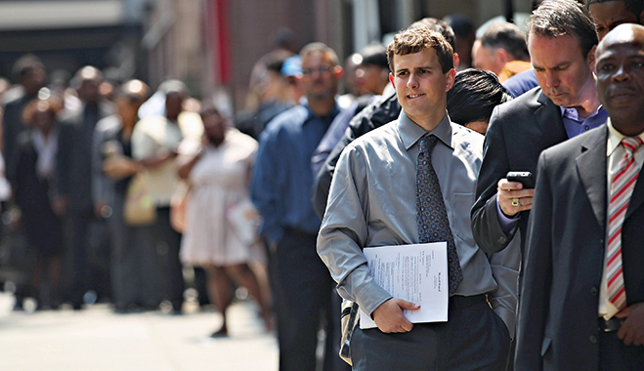
Conclusion – What I Learned
Consistency between poverty rate and unemployment rate
Unemployment usually dips a little lower than poverty
The two are closely related

Slide 9

Sources
https://www.bls.gov/opub/ted/2019/official-unemployment-rate-was-3-point-9-percent-in-december-2018-u-6-was-7-point-6-percent.htm?view_full
https://www.latimes.com/archives/la-xpm-2005-aug-31-na-income31-story.html
www.census.gov

